Slide 1
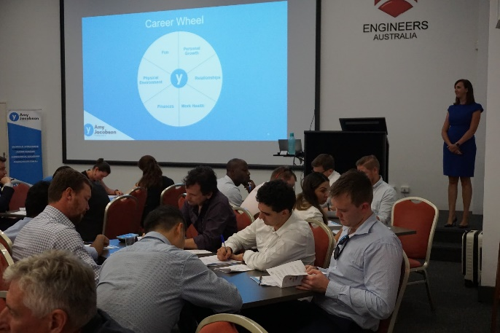
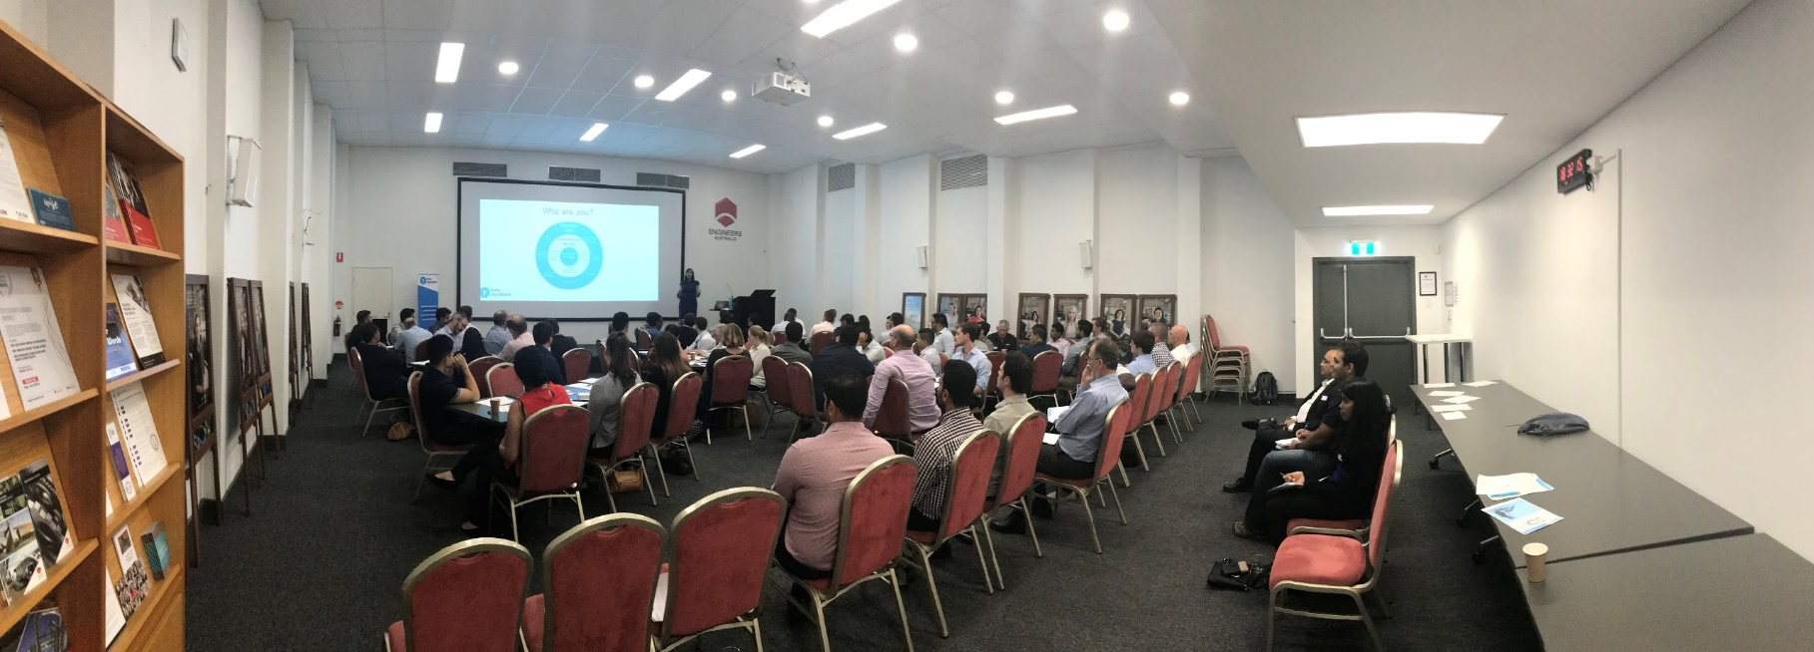
Industry Mentoring Program 2025
Eight industry societies
Events throughout the year focus on networking, communication and leadership skills
2025 Applications Now Open!
Click Here to Apply
Next years intake
opening January 2010!

