Slide 1





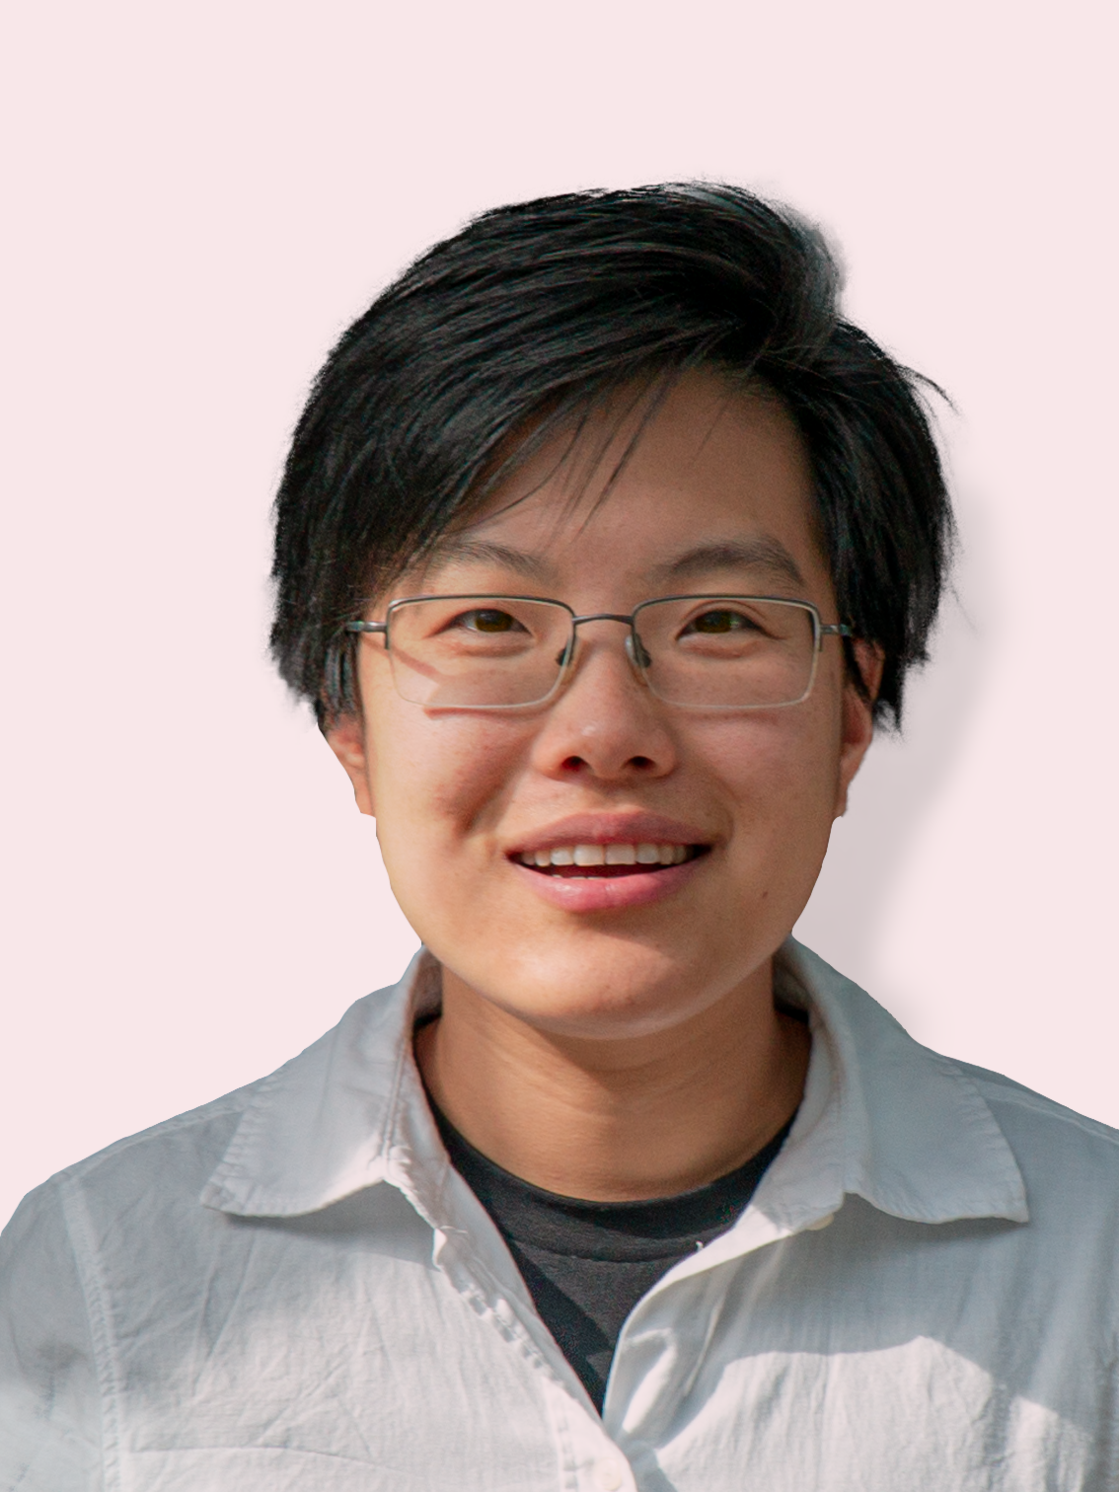
Thank you to our event sponsor:
OSIGp Prize 2024
Wednesday 4th December 2024
IOMRC Auditorium, UWA
Registration 5.30 pm
Presentations: 6.00 pm – 7.00 pm
Networking over drinks and finger food: 7.00 pm – 8.00 pm
Award Ceremony
Duy Anh Dao
Hamburg University of Technology
Numerical and Experimental Investigation of Anchor-Soil Interaction for Floating Offshore Wind Turbines
Junlin Rong
WSP Australia
A Dynamic Penetrometer for Offshore Geotechnical Investigation
Yishan Tian
Fugro Belgium
A new CPT-Based Pile and Penetrometer end bearing assessment method
REGISTER NOW
Category | Registration Fee
Student SUT Members | Free
SUT Members | $ 10
Non-members | $ 15
Online* | $ 5
https://www.eventbrite.com.au/e/osigp-prize-2024-award-ceremony-tickets
*Link to the online event will be shared with registrant’s e-mail address.
Payment during the registration process is required in order to secure your place/s. If paying by credit card, it will be deducted at the time of registration and a confirmation email with the receipt/tax invoice from Eventbrite will be forwarded to the stipulated email address. If paying by invoice, it will be sent to your email address at time of registration and payment will be required within 14 days from receipt of invoice. If payment is not received within this time, your registration may be cancelled.

